Slide 1
Plant Cloning

Slide 2
When you read the word 'clone' what comes to mind?
An exact copy of something should hopefully be your first thought. During this Smart Lesson you will learn about plant cloning and the jobs involved in this field of work.

Slide 3
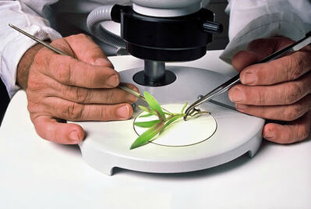
People have been cloning plants in one way or another for thousands of years.

Slide 4
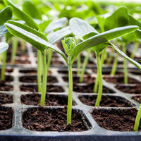
For example, you are creating a clone of the original plant when you take a leaf cutting from a plant and grow it into a new plant. The reason it is a clone of the original plant is because the new plant has the exact same genetic makeup as the original.
This is called vegetative propagation.

Slide 5
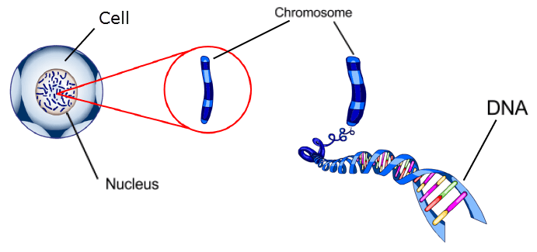
A clone has only one parent and is an exact genetic copy of that parent.

Slide 6

Why do we clone plants?
To select plants that have particular desirable properties like a high produce rate or pleasant flavors.

Slide 7
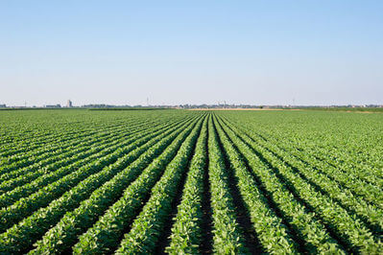
Humans have constantly searched for improved forms of their crop plants. Better produce rates and nutritional qualities.
An answer for this is gene cloning.

Slide 8
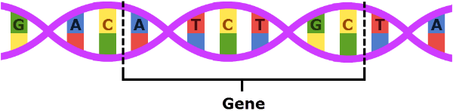
Information in DNA is stored in genes.
Genes are lengths of DNA, strung one after another like words in a sentence.

Slide 9

Gene cloning is a common technique carried out in biology labs that is used by researchers to create copies of a particular gene.

Slide 10

Wait a minute, what does gene cloning have to do with plants?

Slide 11
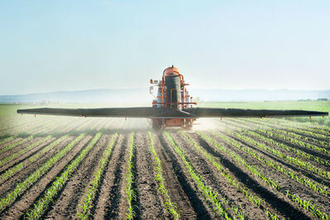
Farmers are excited because gene cloning provides a new and exciting aspect into growing crops.

Slide 12
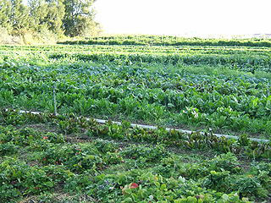
The development of genetically modified crops allows farmers to pick and choose the traits of their crop.

Slide 13
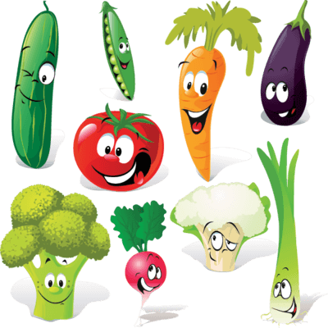
Vegetable farming is the growing of vegetables for humans to eat.
Vegetable farmers can pick valued traits like pest resistance or drought and salt tolerance for optimum growth effects.

Slide 14
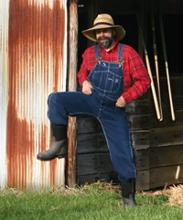
How are peoples lives affected by cloning?
Favourable traits + successful growth rate = more money for farmers and more veggies for us!
From this, you can see why farmers and us, the consumers, are affected by genetic cloning.

Slide 15

The cloning of plants has been hugely successful. The next step in cloning is making people extremely uncomfortable. Human cloning.
Human cloning is possibly one of the most heated and relevant ethical debates of our time. Is this a step too far? Something for you to ponder about!

